Slide 1
How to remove a security key from your Salesforce account
This guide will walk you through the process of how to remove a security key if you have one registered for MFA on your Salesforce account

Slide 2
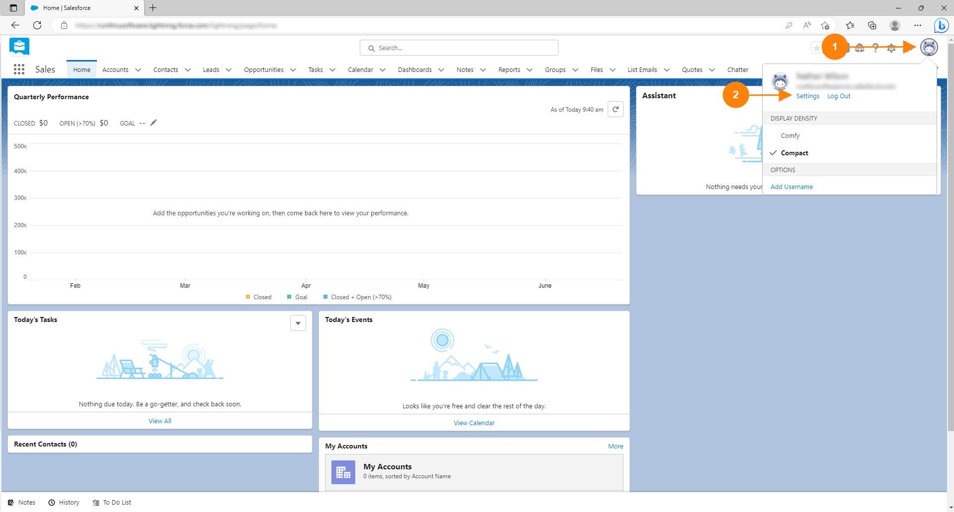
Add Title
1. Click on your profile picture
2. Click on Settings

Slide 3
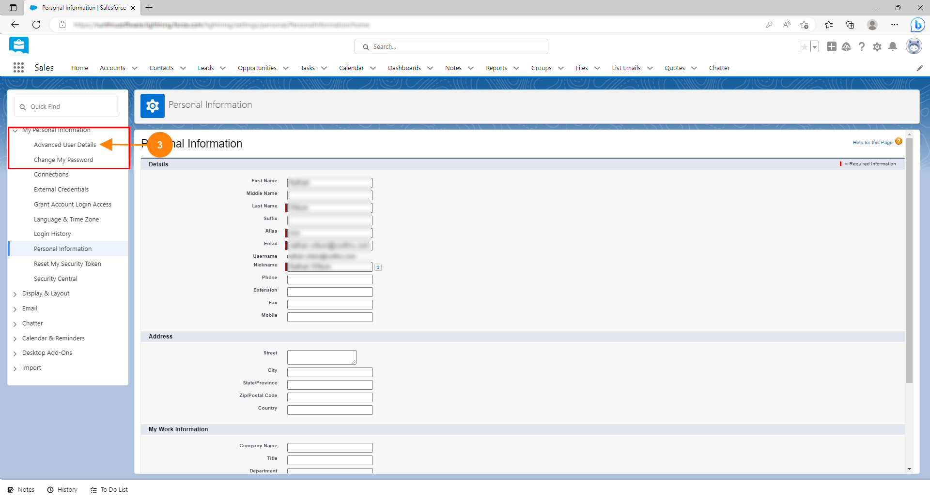
Add Title
3. Click on Advanced User Details in the My Personal Information Section

Slide 4
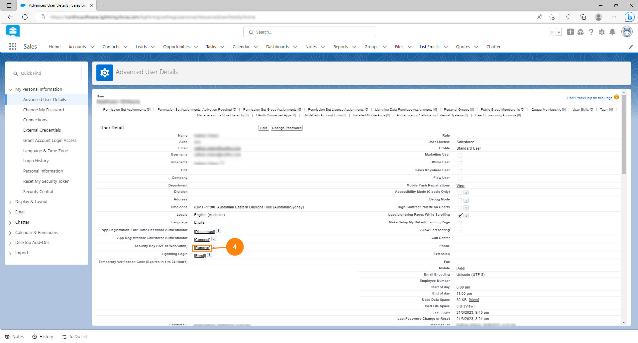
Add Title
4. Click the [Remove] button inline with Security Key as shown.

Slide 5

Add Title
5. The button will now say [Register] indicating that you have successfully removed your key

Slide 6
You're done!
Congratulations, you've reached the end of the guide

