Slide 1
How to register a security key to your Salesforce account
This guide will run you through the process.

Slide 2
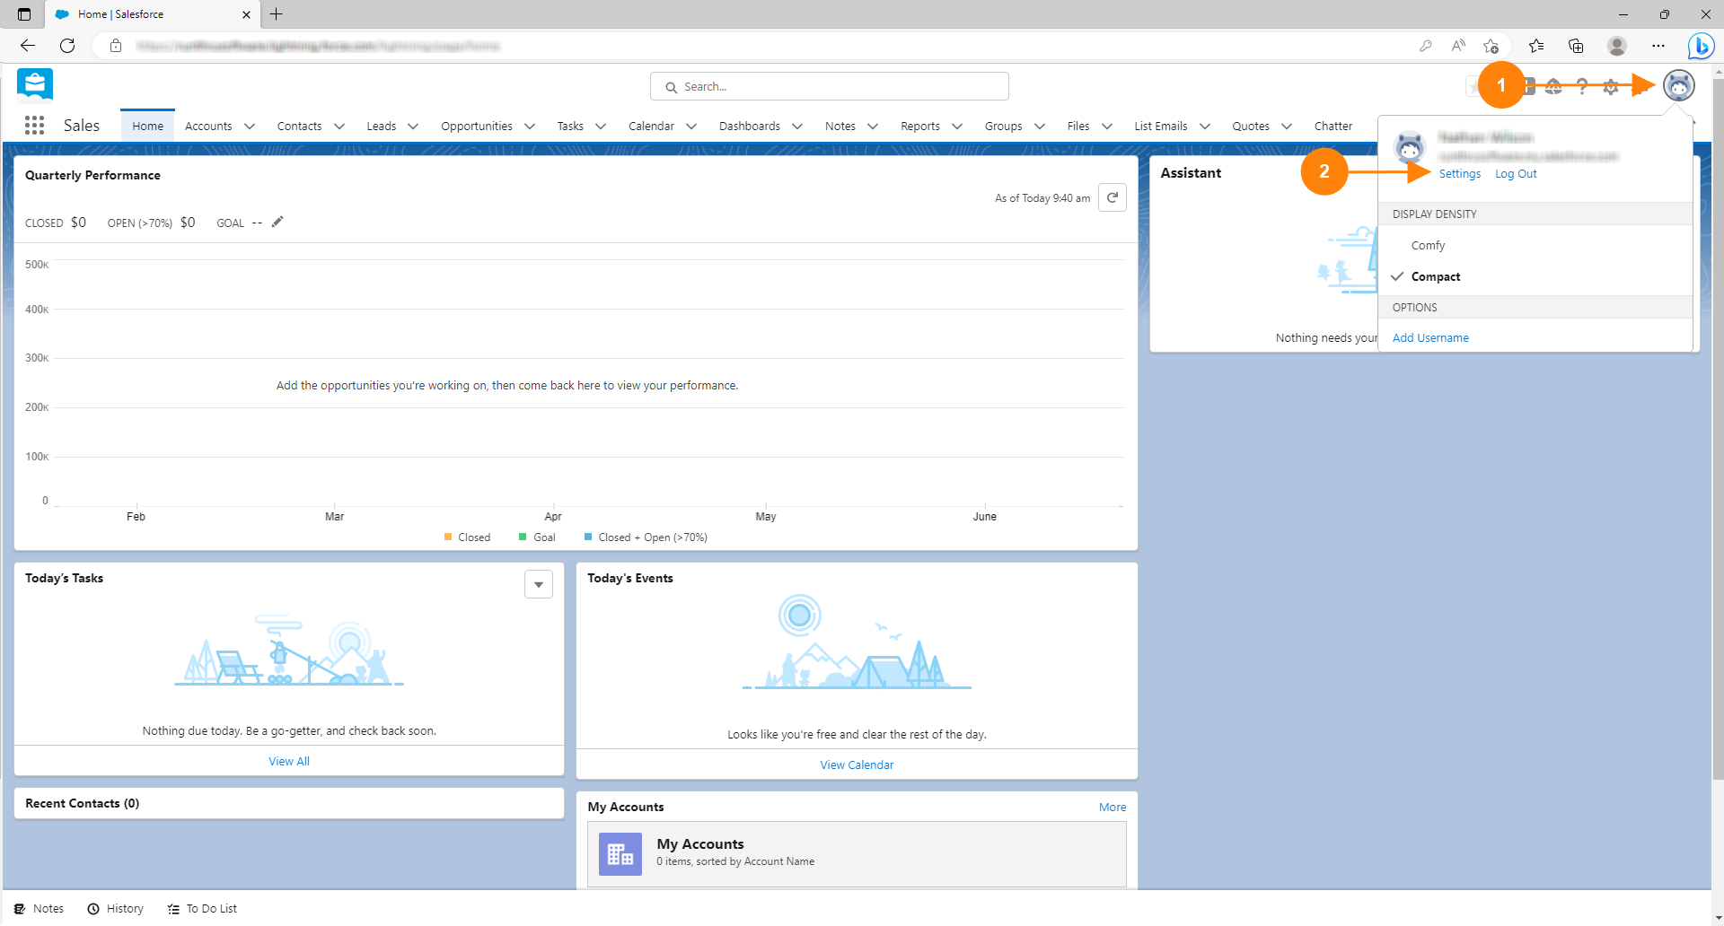
1. Click on your profile picture
2. Click on Settings

Slide 3
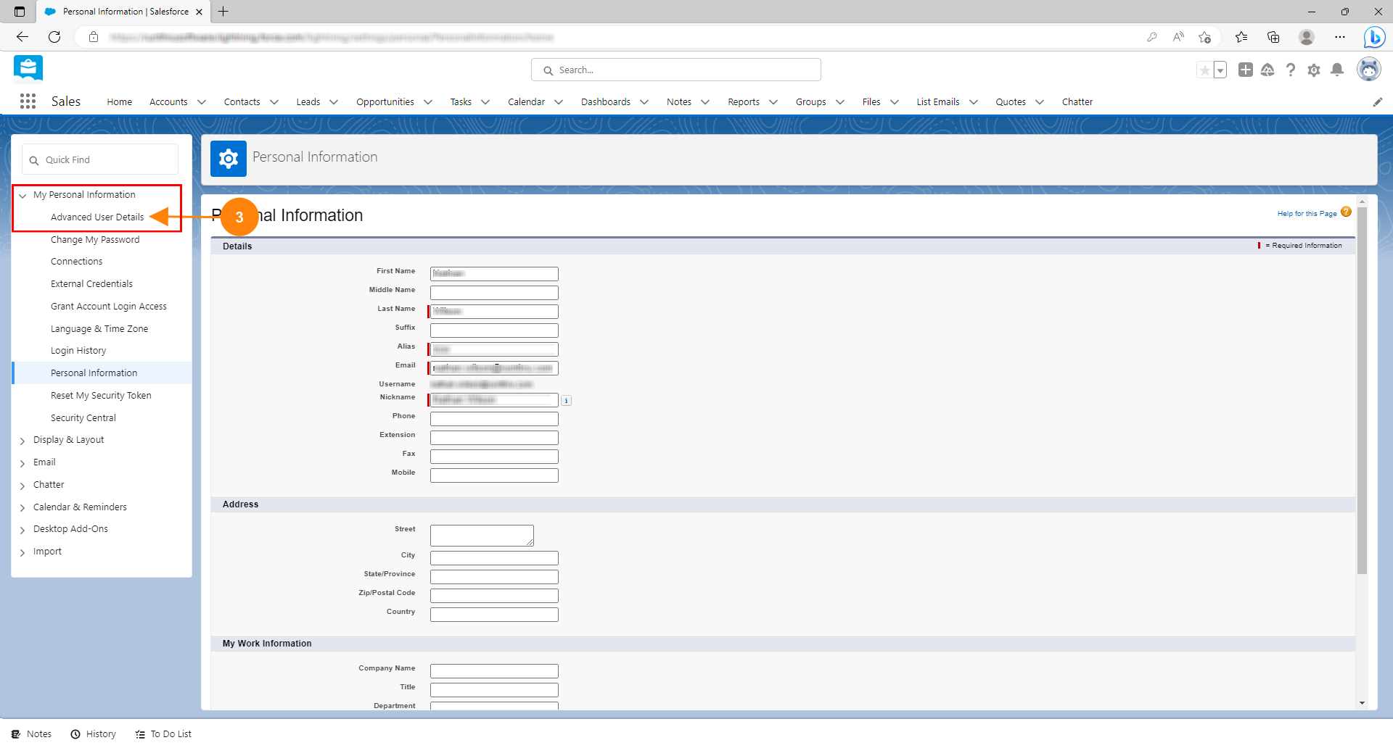
3. Click on Advanced User Details in the My Personal Information Section

Slide 4
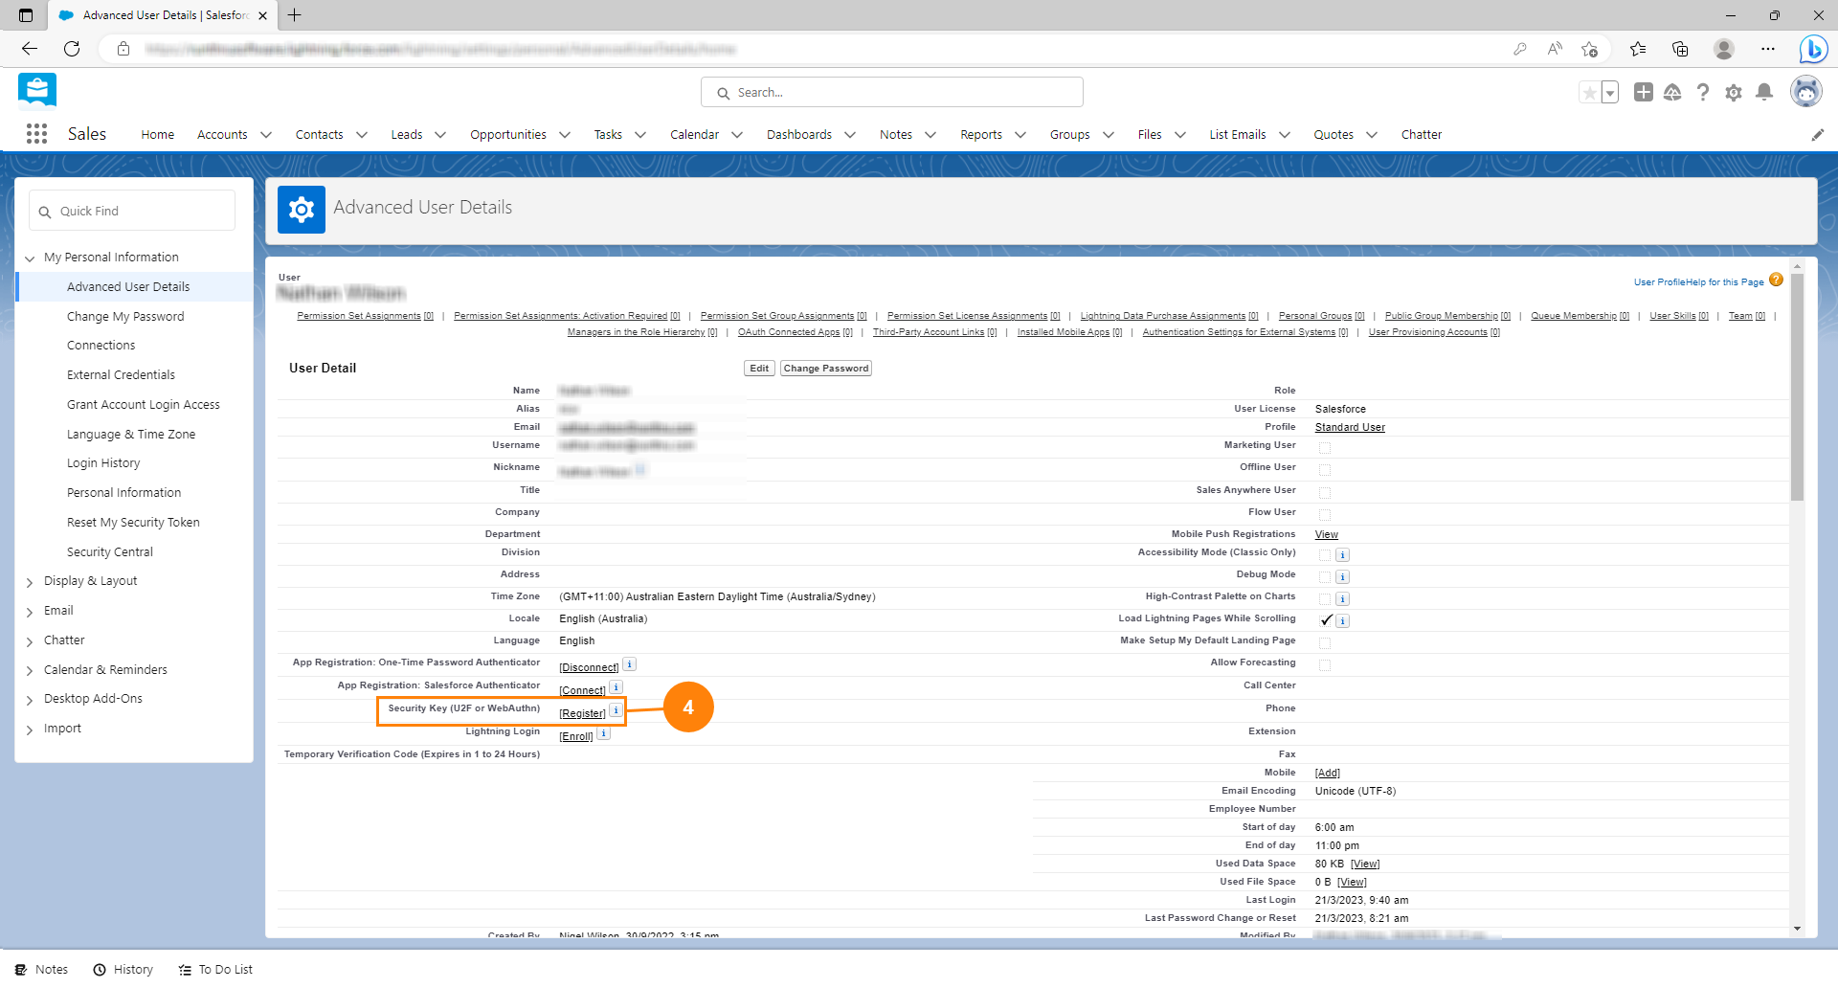
4. Click [Register] on the Security Key line. If you don't see the Security Key line please contact your Salesforce Administrator.

Slide 5
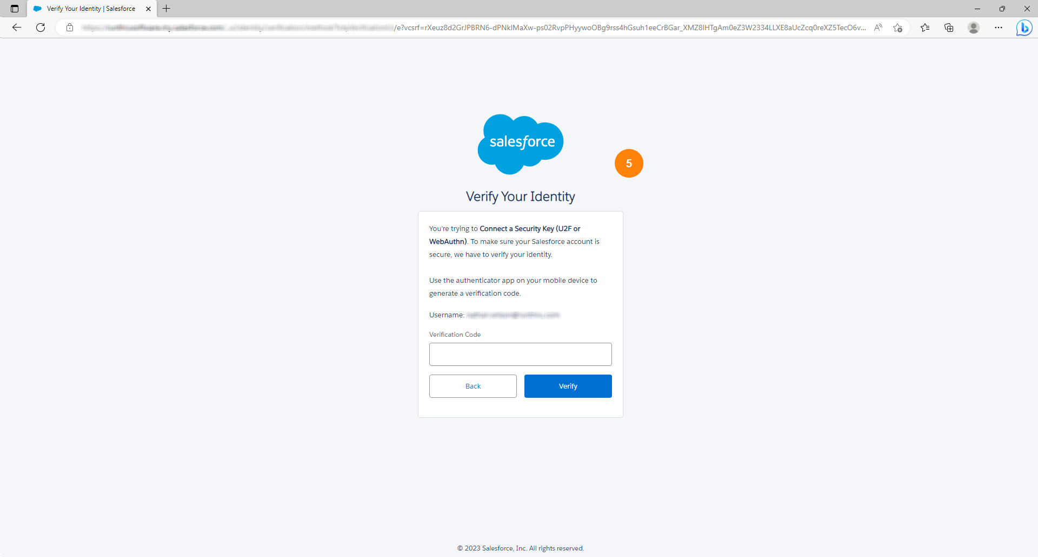
5. If prompted, verify yourself.

Slide 6
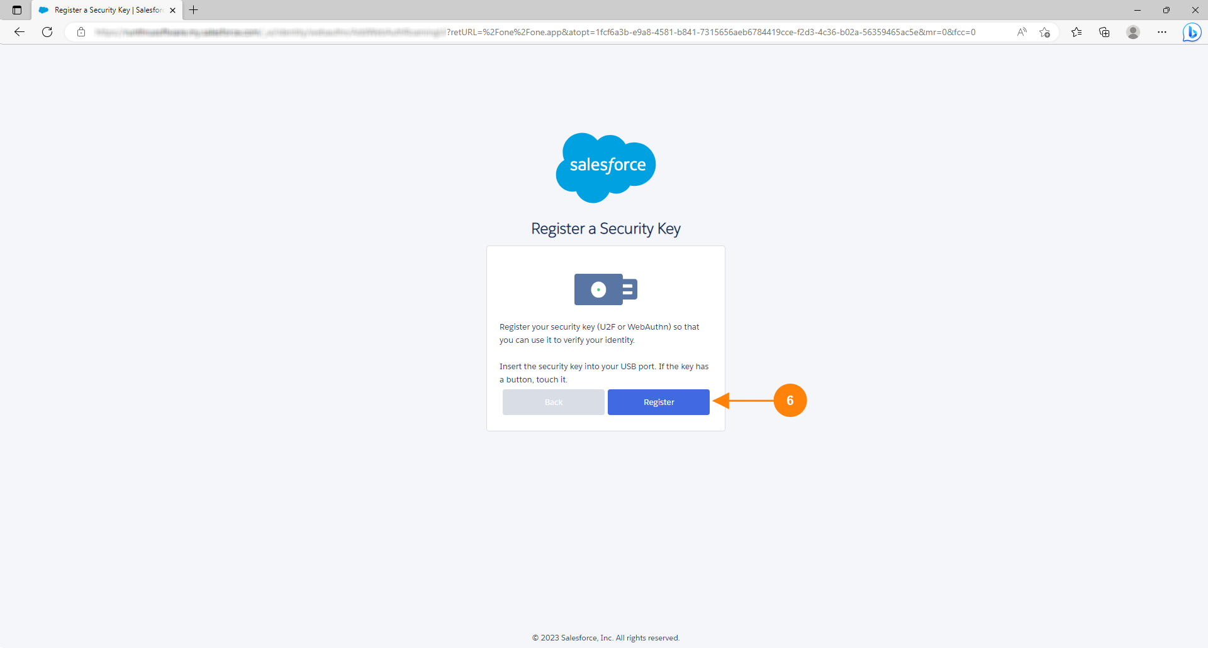
6. Click Register

Slide 7
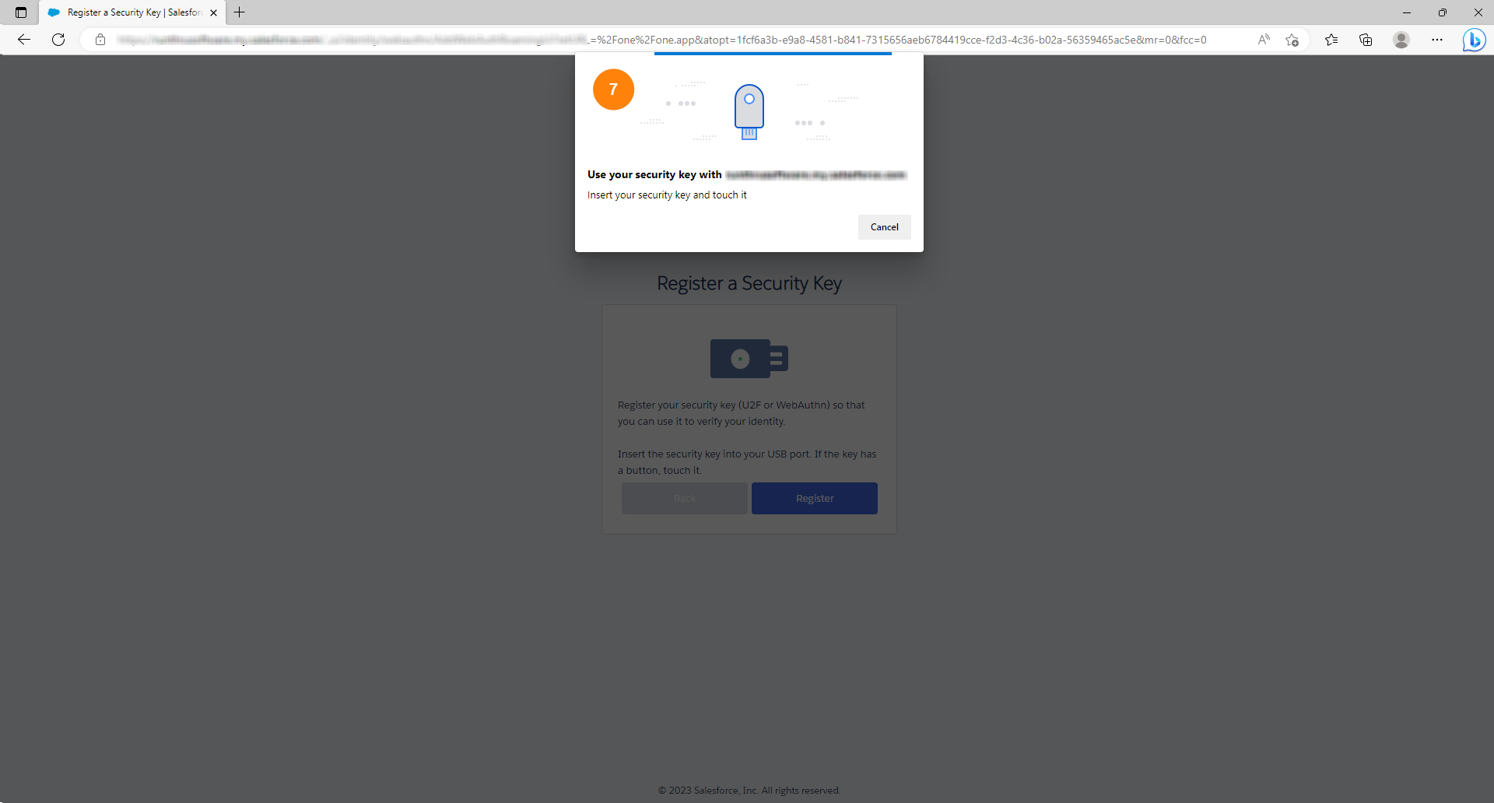
7. Follow the prompts from your browser and OS

Slide 8
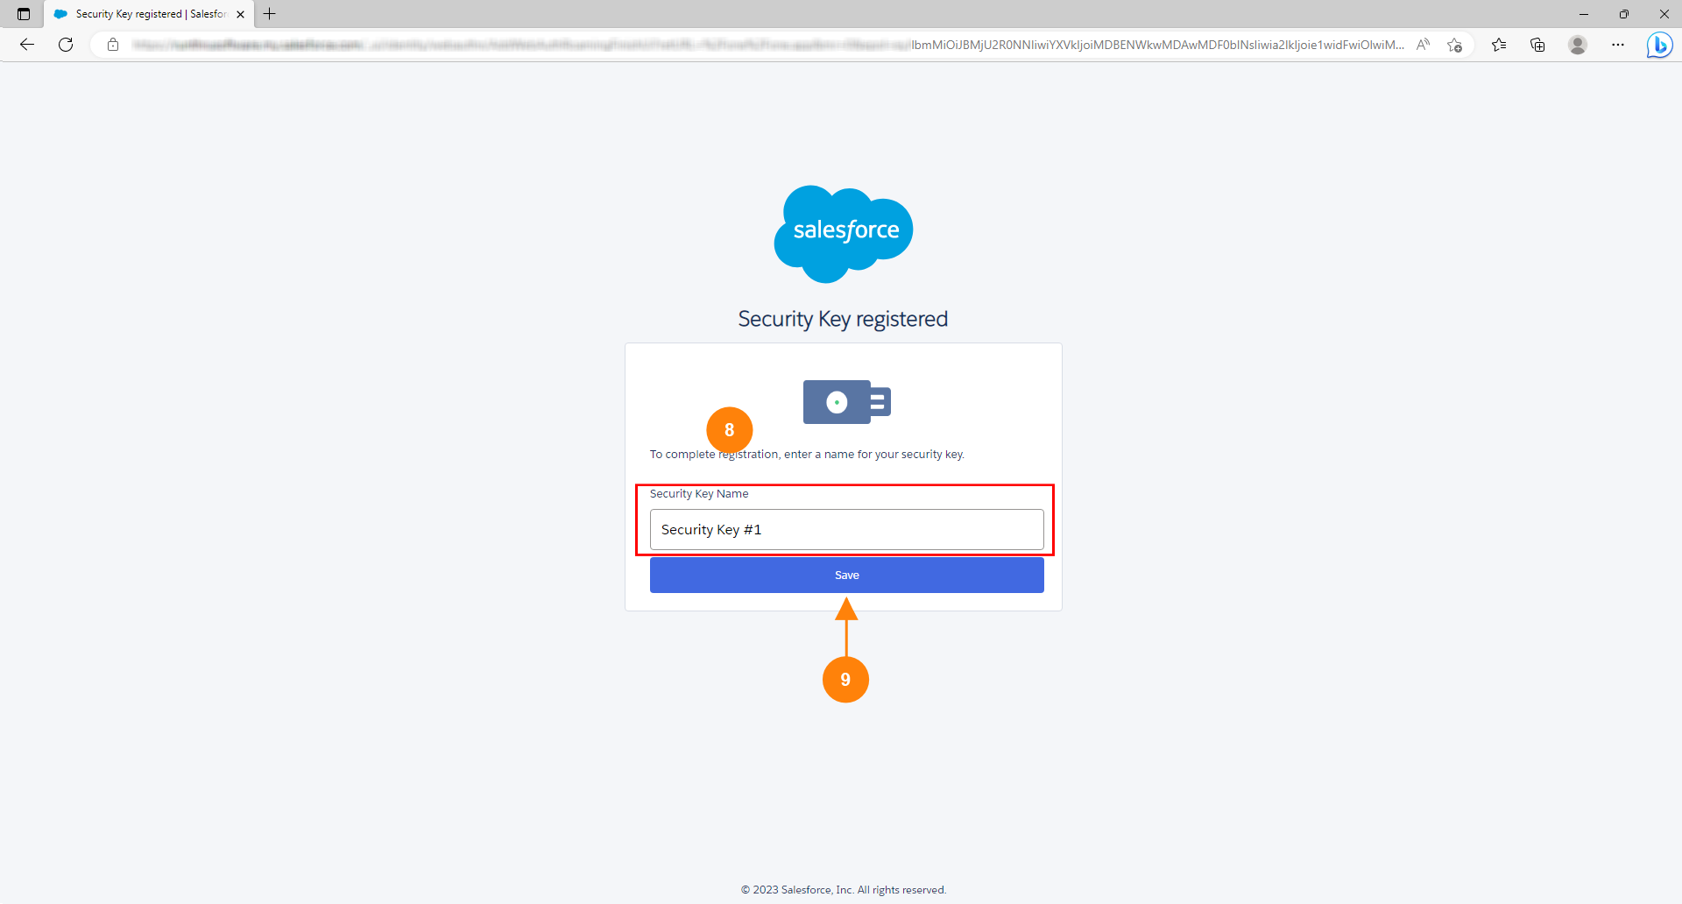
8. Give your key a name so you can identify it in Salesforce later
9. Click Save

Slide 9
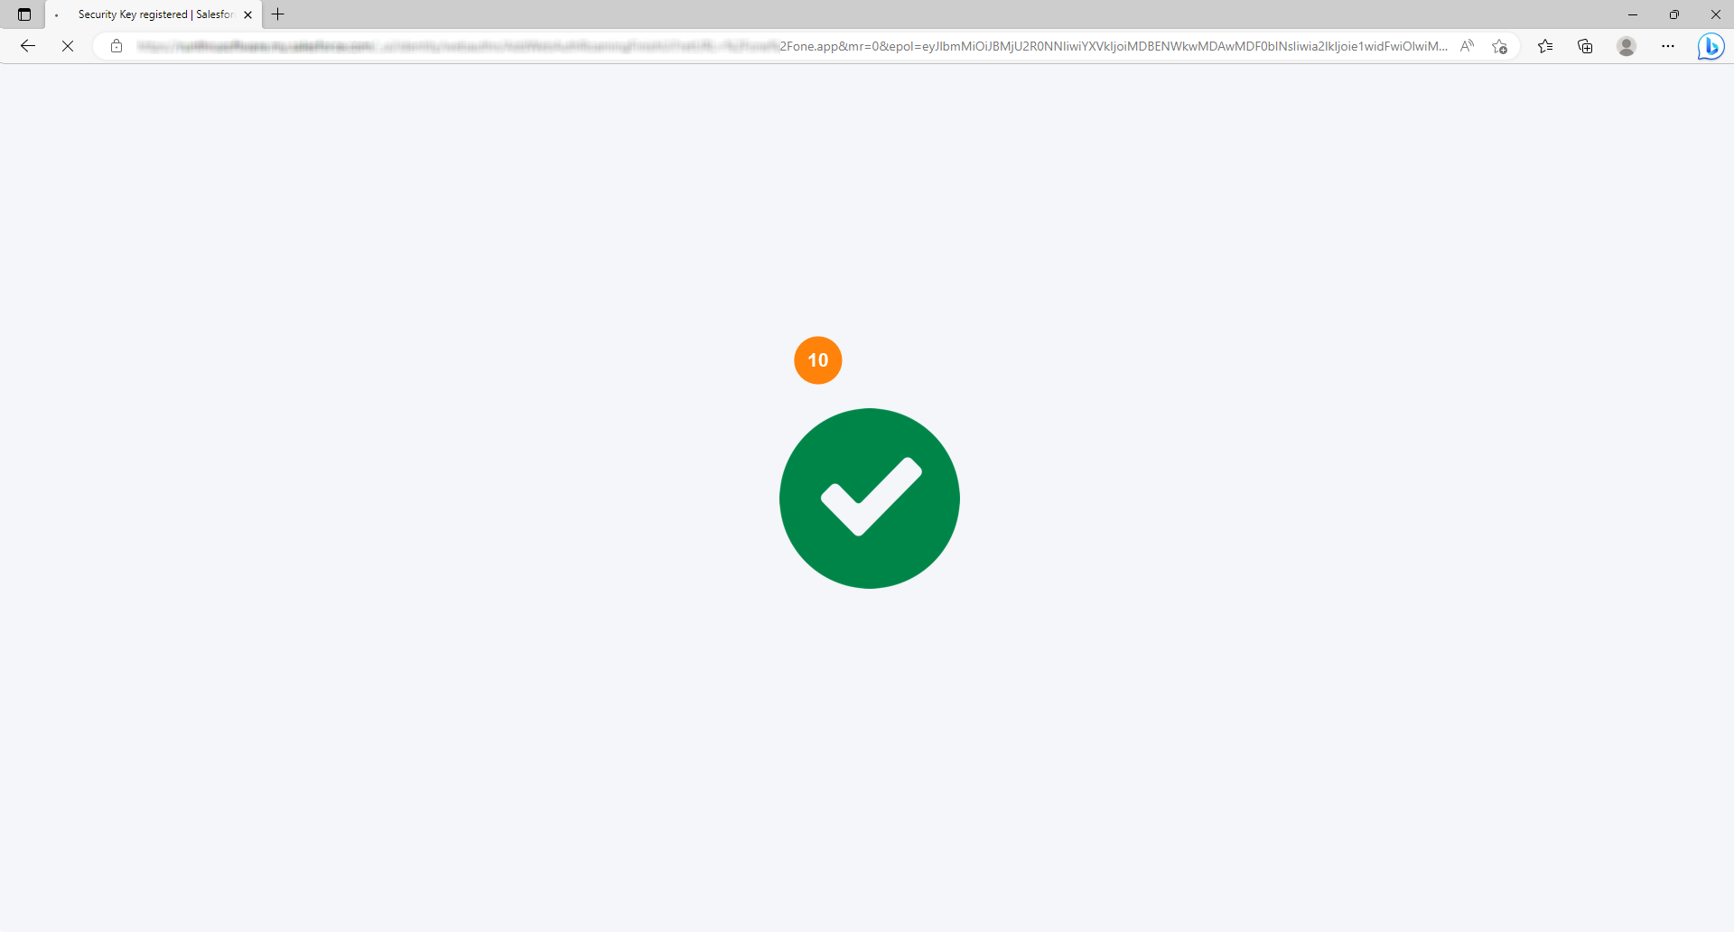
10. You will see a green checkmark appear confirming that you've successfully added your security key to your Salesforce account

Slide 10
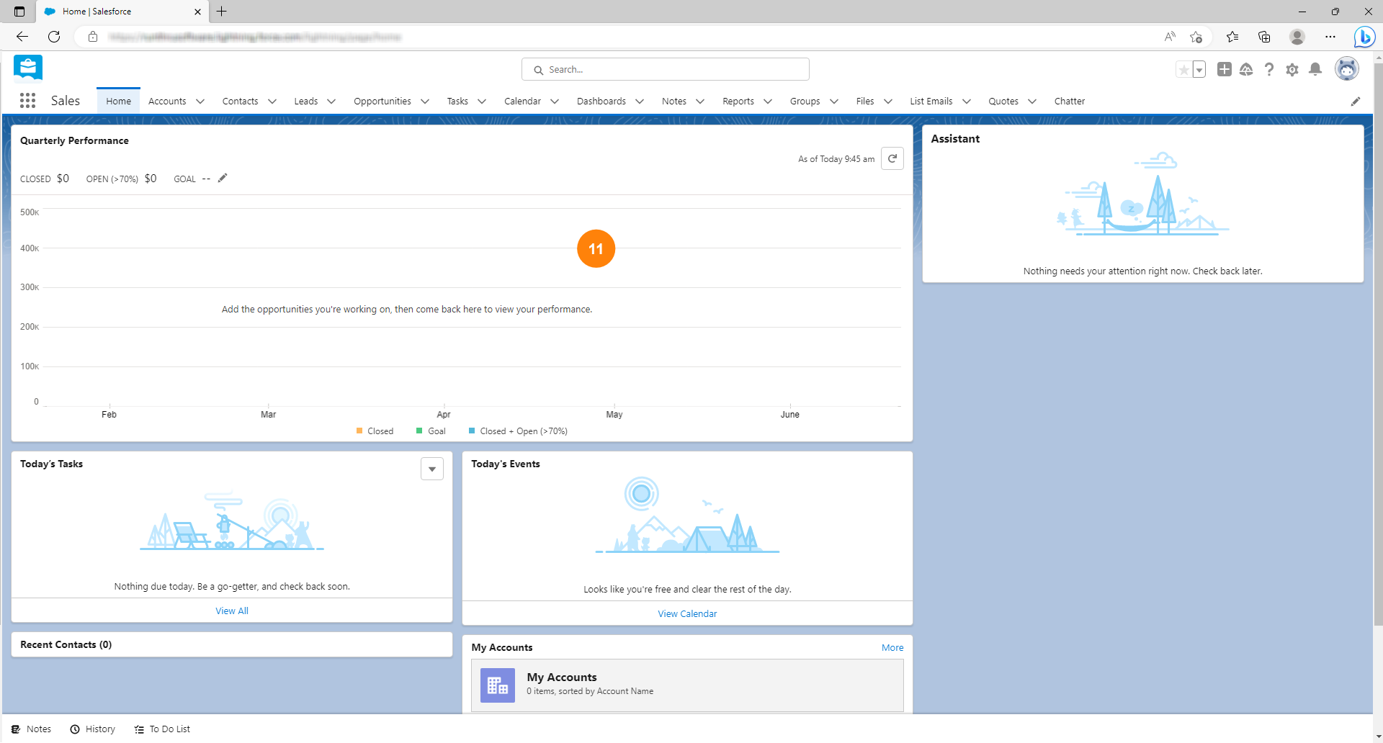
11. You will be redirected back to the home page

Slide 11
You're done!
Congratulations, you've reached the end of the guide.
You can now use your security key as your 2nd factor of authentication when signing into Salesforce

