Slide 1
How to enable security keys for your company's Salesforce account
This guide will run you through the process of how to enable users to use a security key as a MFA option.

Slide 2
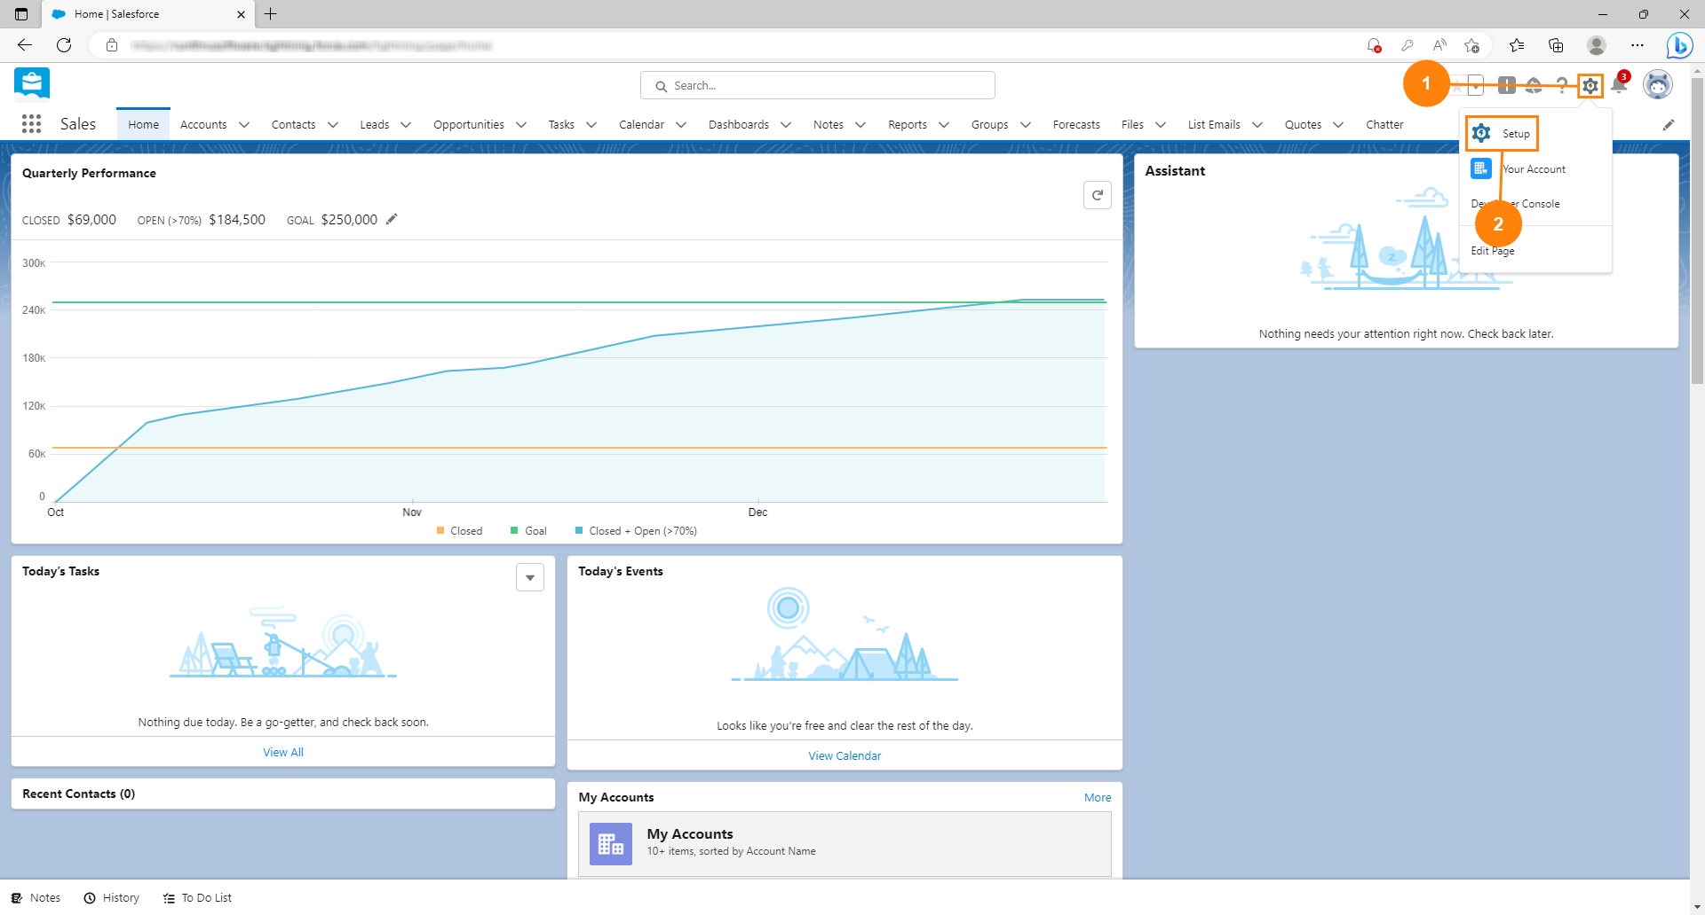
1. Click the gear
2. Click Setup

Slide 3
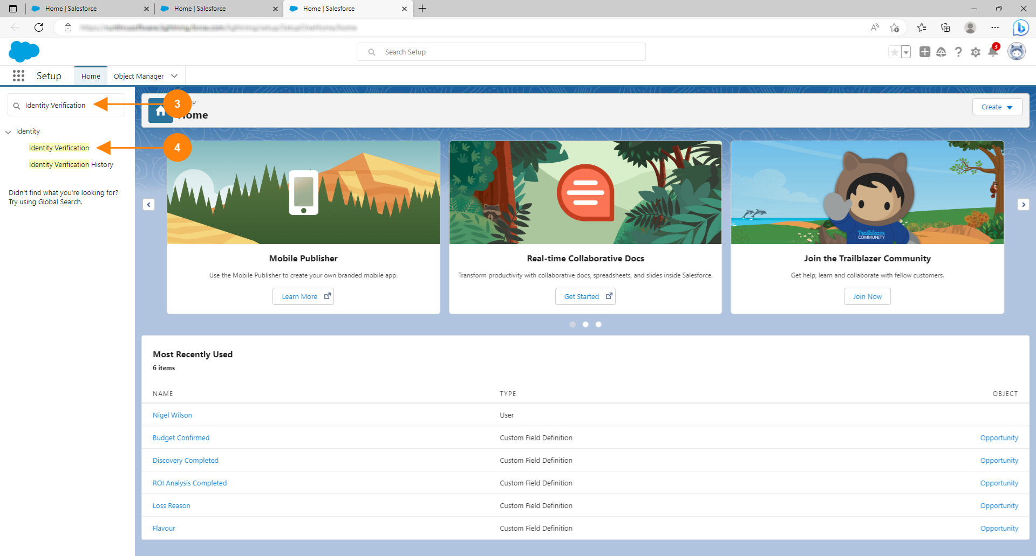
3. Search for Identity Verification.
4. Click Identity Verification

Slide 4
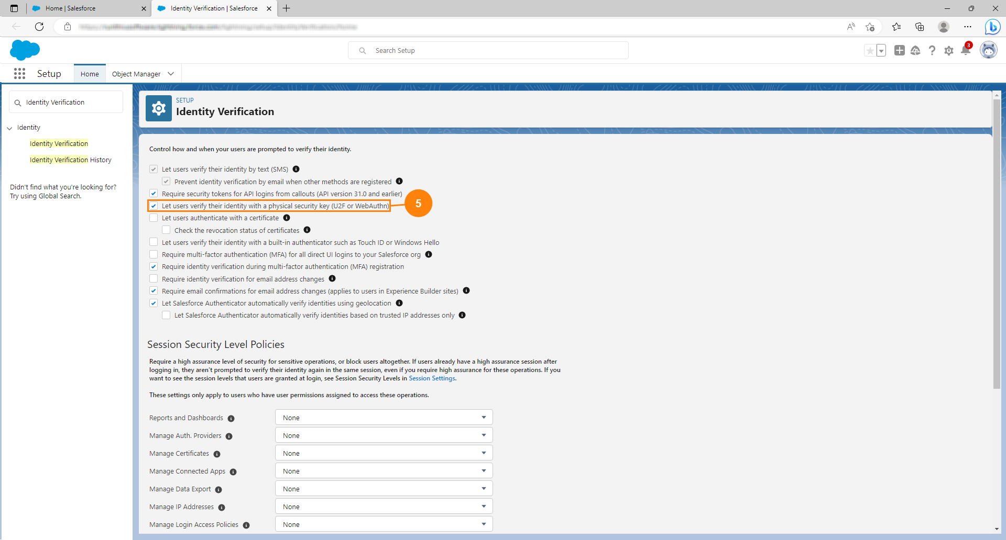
5. Check let users verify their identity... as shown.

Slide 5
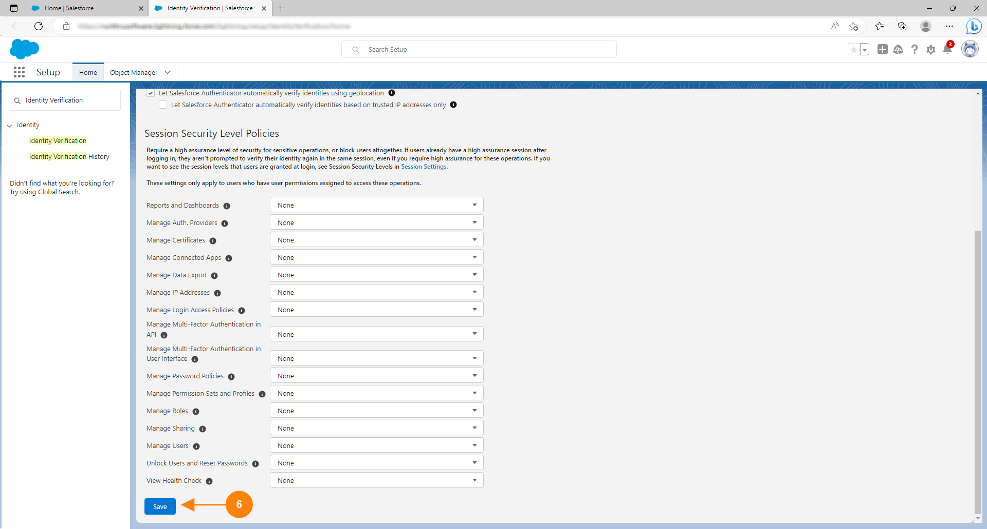
6. Scroll to the bottom of the page and click Save.

Slide 6
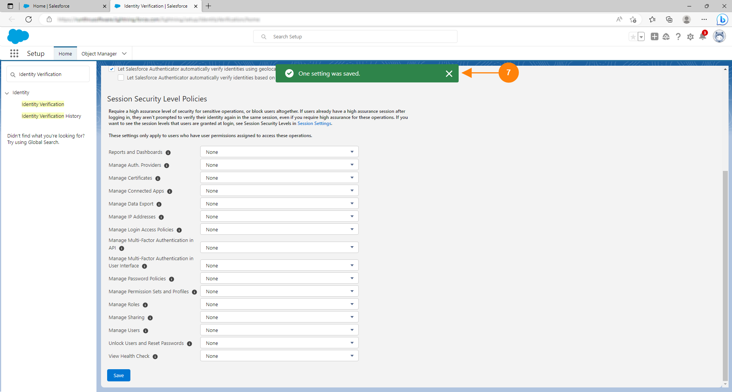
7. You should see a notification popup telling you that the setting has been saved

Slide 7
You're done!
Congratulations, you've reached the end of the guide.
Users can now register and use security keys as a 2nd factor of authentication when signing into Salesforce

